Slide 1
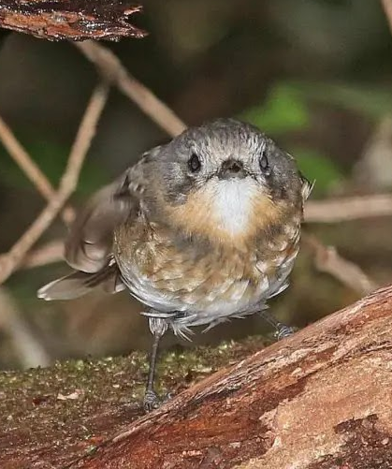
Hawaiian endemic species classifier
Yu-zhen, CHEN & Frederic Michel, Ortega
Video link: https://youtu.be/LpZVgIAE4ik

Slide 2
Table of contents
03
01
04
02
05
Evaluation & Results
The accuracy and confusion matrix of results
Dataset Collection
Enhancement & Limitations
The process of our dataset collection
Making enhancements and re-training
Model Construction
Future works & Ideas
Classification model construction and explanation
Implemented solution and further works.

Slide 3
Overview of project
In this machine learning project, we developed a Hawaiian endemic species classifier capable of distinguishing between five distinct species native to the Hawaiian islands. The selected species include the Hawaiian goose, Apapane, Hawaiian Coot, Amakihi, and Elepaio. The primary challenge in selecting these species was ensuring the availability of a sufficient number of images for model training.
We employed convolutional neural networks (CNNs) for image classification, utilizing a dataset collected by ourselves. Our model achieved a high level of accuracy, demonstrating its effectiveness in identifying these Hawaiian endemic species. This project contributes to the conservation efforts of Hawaiian wildlife by providing a tool for species monitoring and identification.

Slide 4
Why build this model?
Preservation
Easy identification of endangered species
Easy
The model generates the result within 10 seconds
Accessible
This project will be an open source project

Slide 5
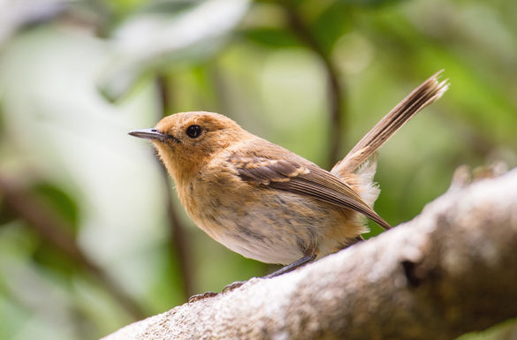
01
Dataset Collection
Collecting the Hawaiian endemic species photos

Slide 6
Our methods
Web Scraping
Fastbook
imagehash
Filter
RGB to BGR
Scrape 5 different species
Remove duplicate images
Filter out irrelevant images
Image preprocessing

Slide 7
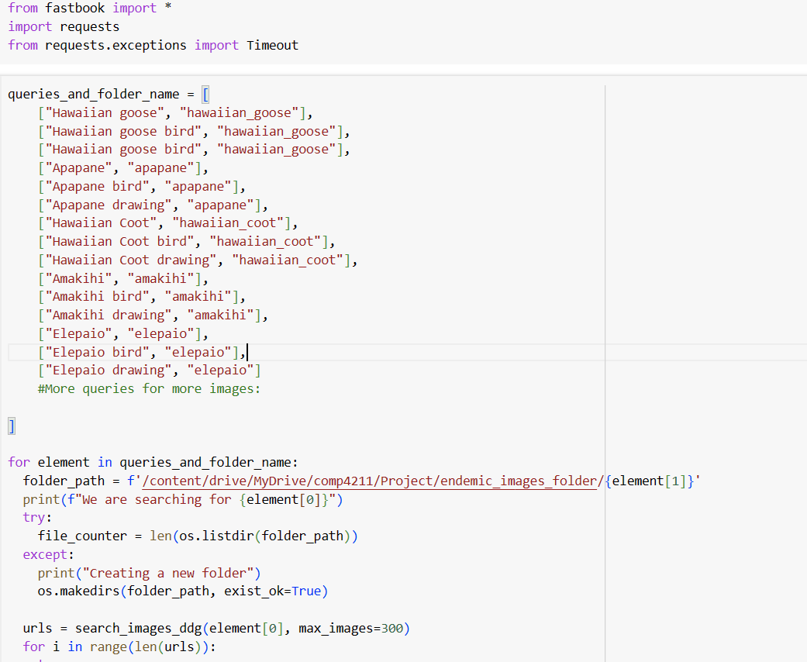
Fastbook usage

Slide 8
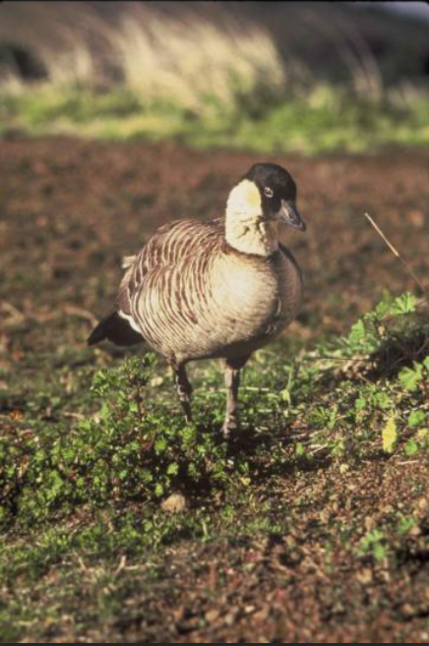
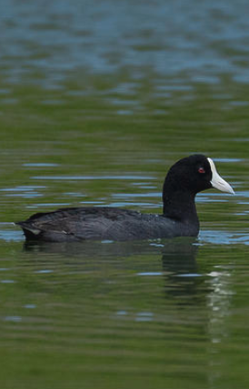
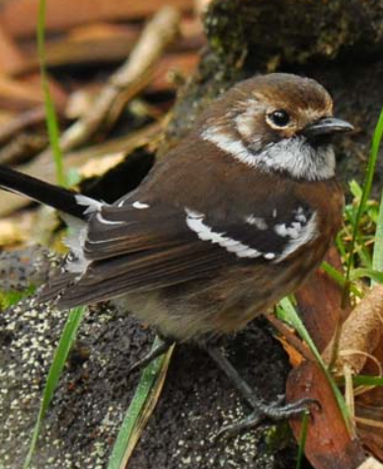
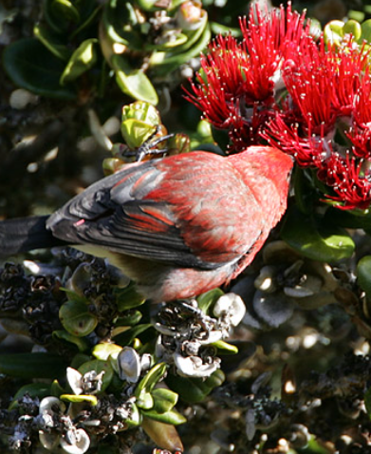
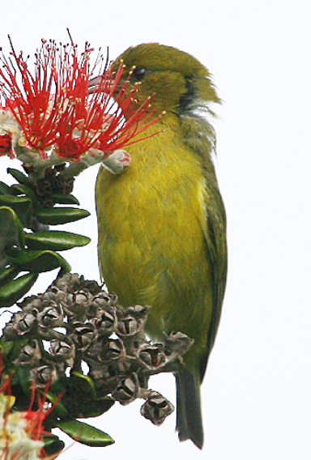
Examples of our dataset
Hawaiian goose
Hawaiian coot
Elepaio
Apapane
Amakihi

Slide 9
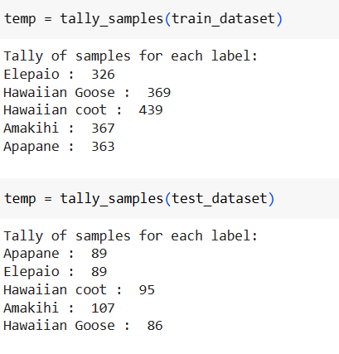
Our obtained dataset

Slide 10
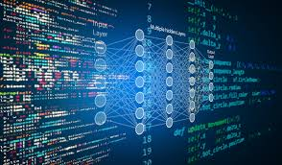
02
Model Construction
Construction of the classification model

Slide 11
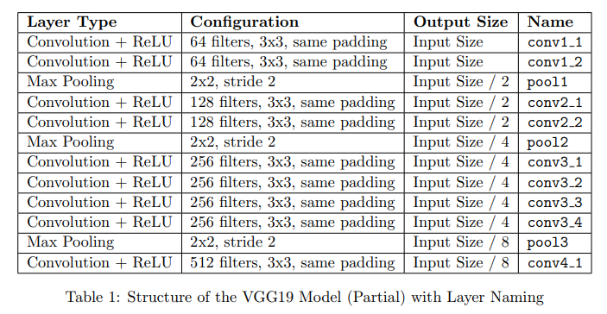
Classification Model
We constructed a VGG19 Classifier up to the conv4_1 layer to serve as our encoder.

Slide 12
Process of construction
Split data
Evaluation
Split the date into train_ds, test_ds
Evaluating the model and planning for enhancements
1st step
3rd step
2nd step
4th step
Encoder
Train model
Construct a Vgg19 Encoder
Train the classification model

Slide 13
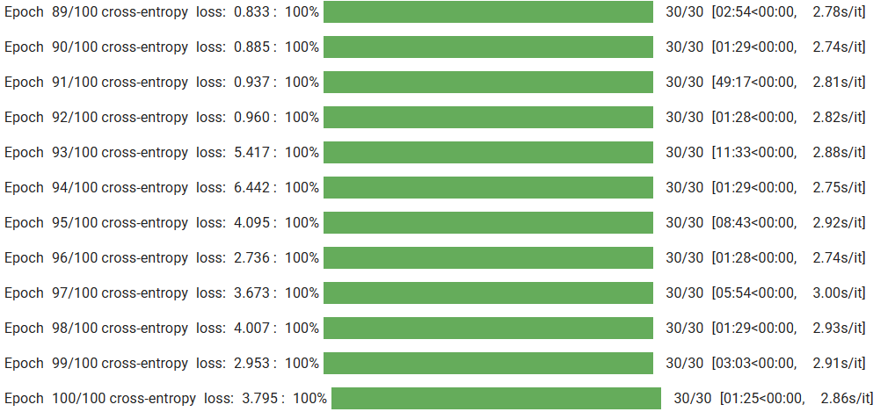
First training of the model

Slide 14

03
Evaluation & Results
Now let’s see what we have achieved!

Slide 15
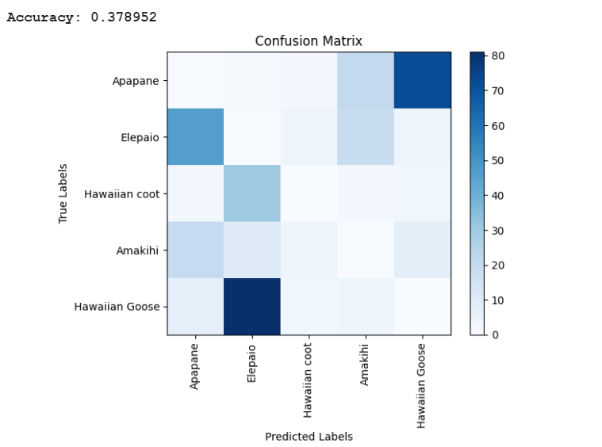
Accuracy & Confusion matrix
Accuracy: 0.378952
A very large amount of wrong predictions are when an image of a Hawaiian Goose is presented, for which the model will tend to predict “Elepaio”.
Another large misprediction is with images of Apapane, for which the model tends to predict Hawaiian Goose instead.

Slide 16
Enhancing the dataset
Acknowledging the low accuracy of the original model, we decided to enhance the dataset for there are wrong images and different backgrounds.
Removal of inappropriate images
Removal of background
There are images that were mislabeled or inappropriate in our dataset folders. Therefore, we manually filtered the dataset that we scraped.
Through the use of pre-trained models, further preprocessing on our images was done to remove the background for all images

Slide 17
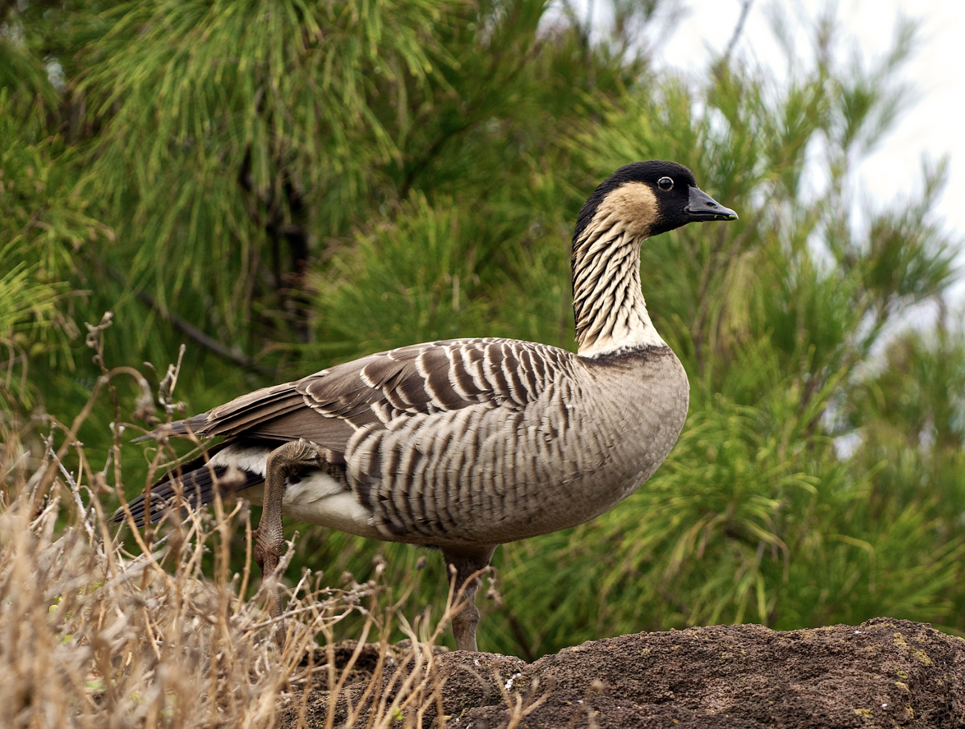
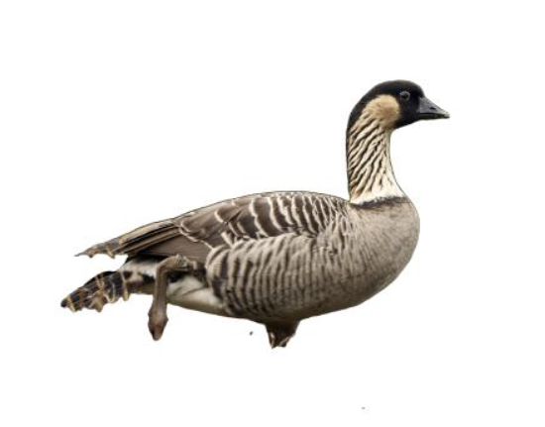
Removal background
Utilizing deeplab pre-trained model, we removed the background of all images in our dataset
Before
After

Slide 18
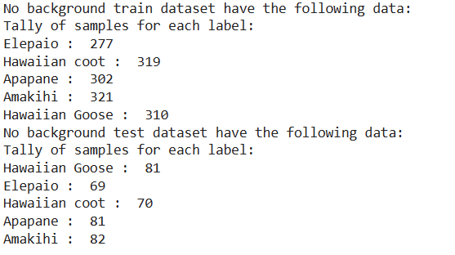
Our new dataset

Slide 19
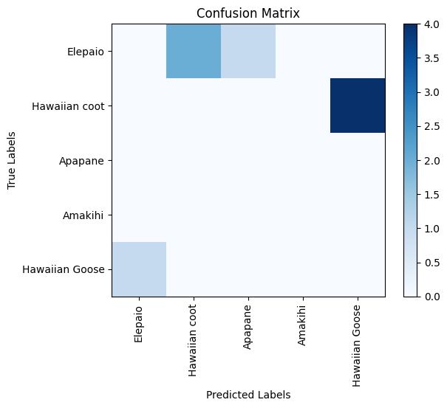
Dataset Enhancement Results
Accuracy: 0.97916666666
A large misprediction is with images of {Hawaiian coot, Hawaiian Goose}, however, it is pretty reasonable that the model interprets it incorrectly for these two animals cause they look similar.

Slide 20
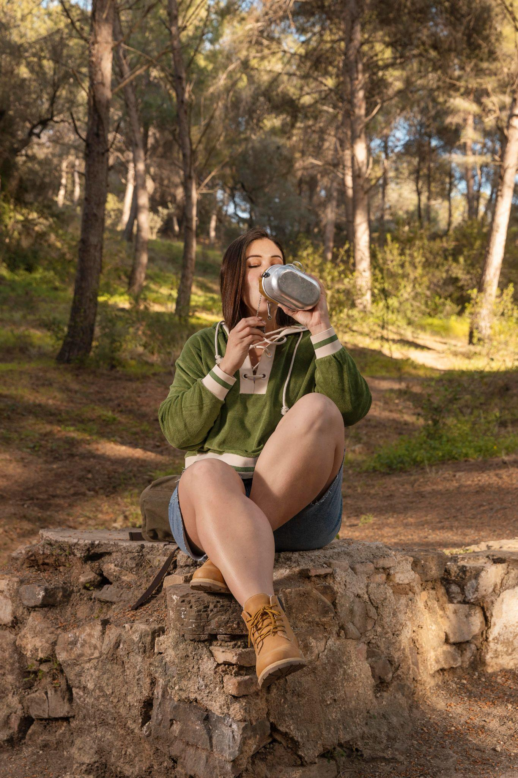
04
Enhancements & Limitations
Now let’s give an overview of our model’s performance

Slide 21
Accuracy of model
38%
97%
Original Dataset
Enhanced Dataset
The dataset scraped directly from the web
The dataset been modified via bg removal and wrong images removal

Slide 22
Limitations
Removing background information
Dependent on Deeplab model
Extensive preprocessing
If the deeplab model fails to remove the background, our model would likely be unable to predict the correct label.
The input image now has to go through more processing (background removal) before being inputted by the model.
By removing the background of the images, we may remove useful patterns that lie within the environment of the animals.

Slide 23

04
Future work & Ideas
What we can do more!

Slide 24
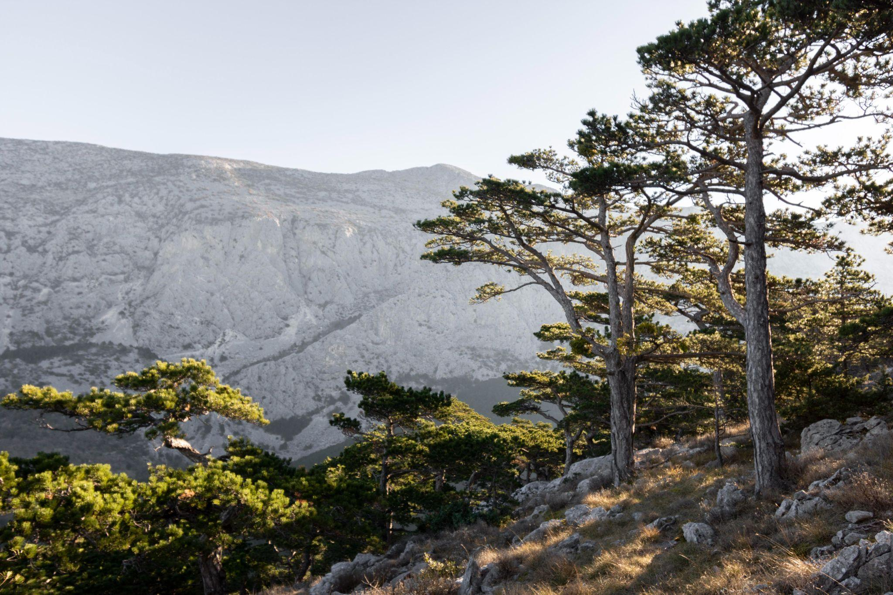
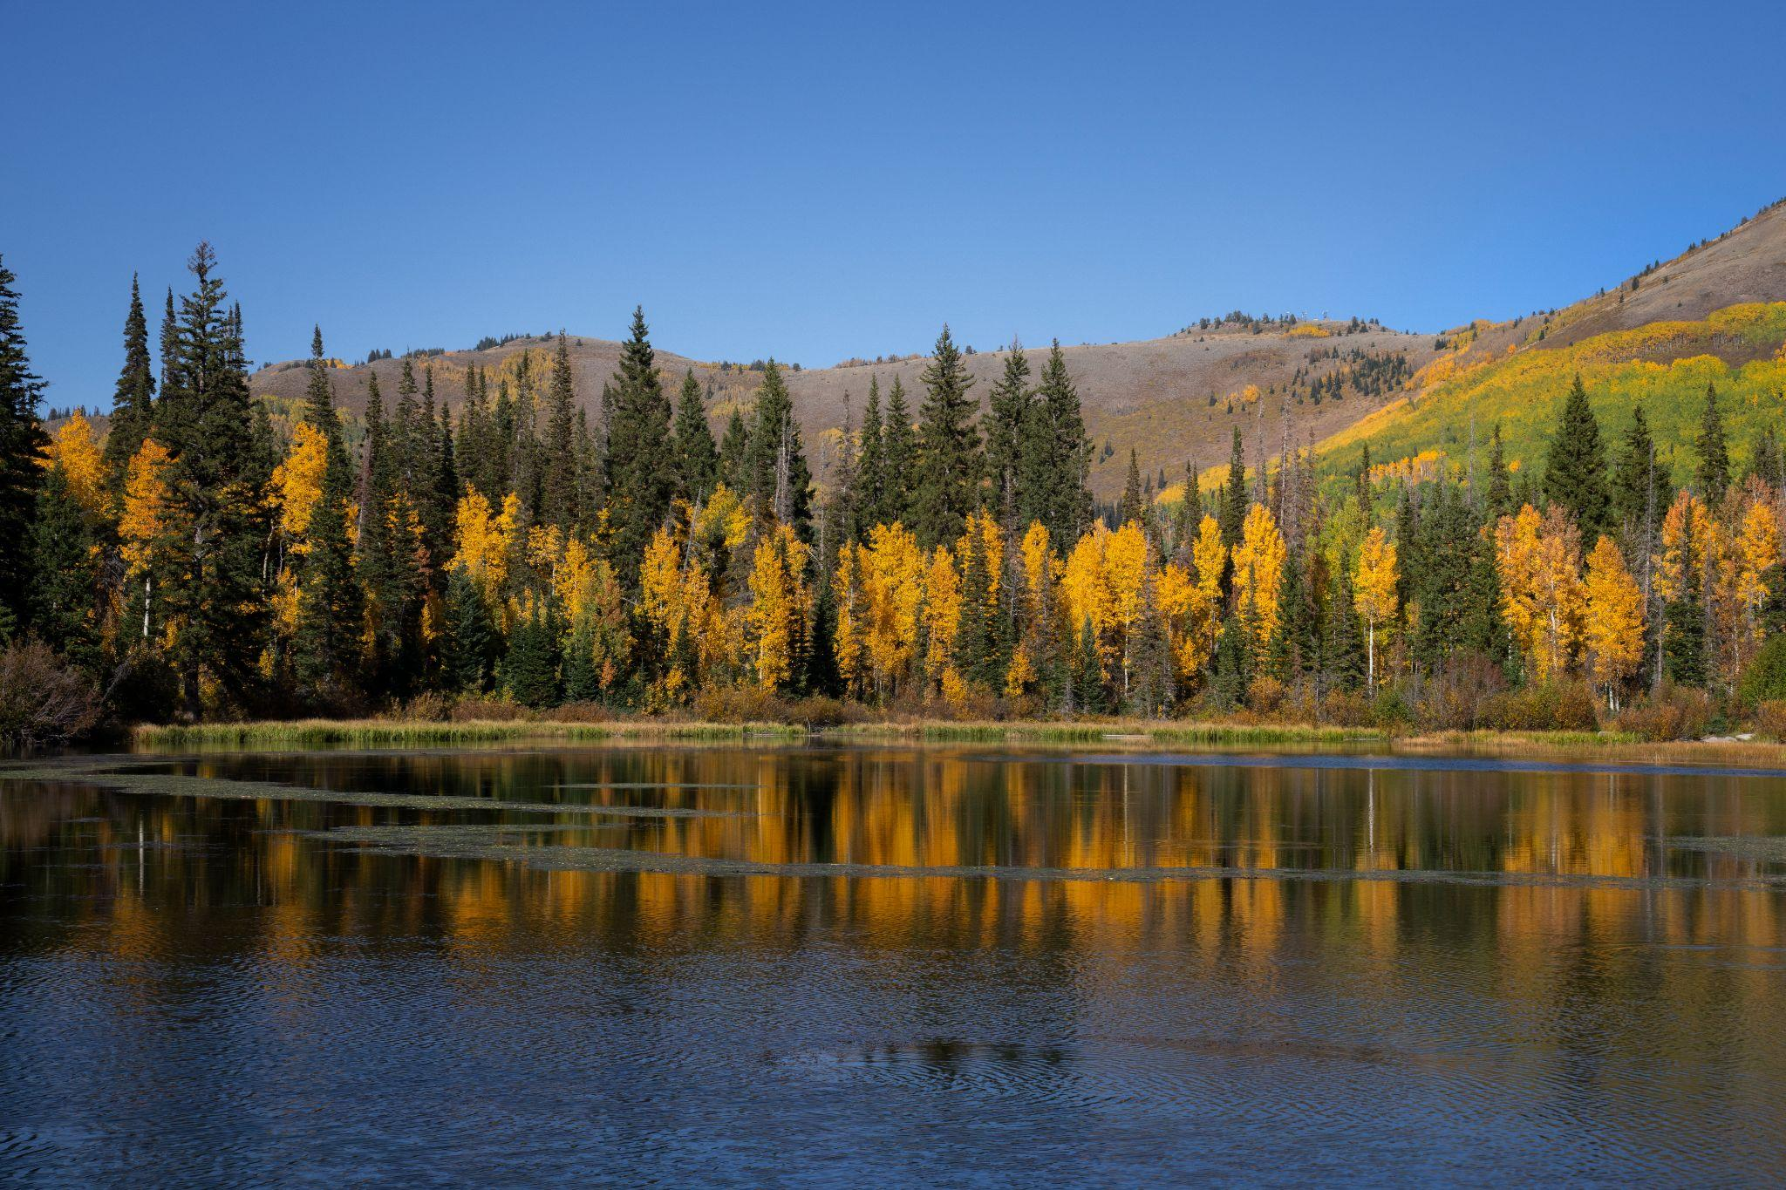
Potential Future works
Image Text Detection
Data augmentation
Using a text detector to prevent our dataset from containing images with watermarks, or logos, which will enhance our dataset quality.
Importing the library ImageDataGenerator would clean data, and may vastly increase the performance of the model

Slide 25
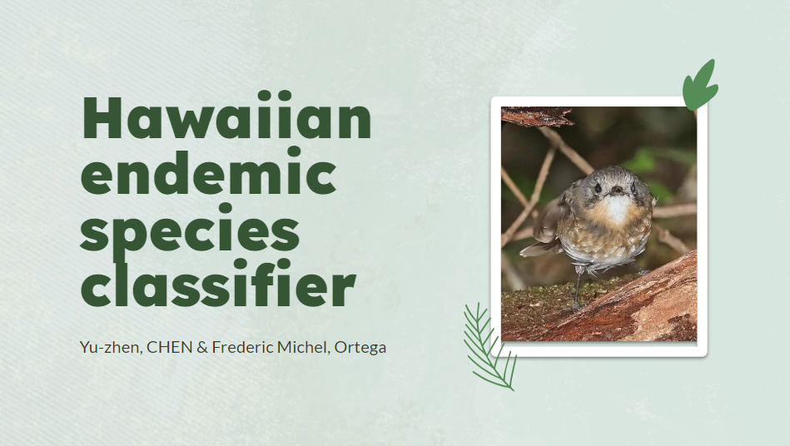
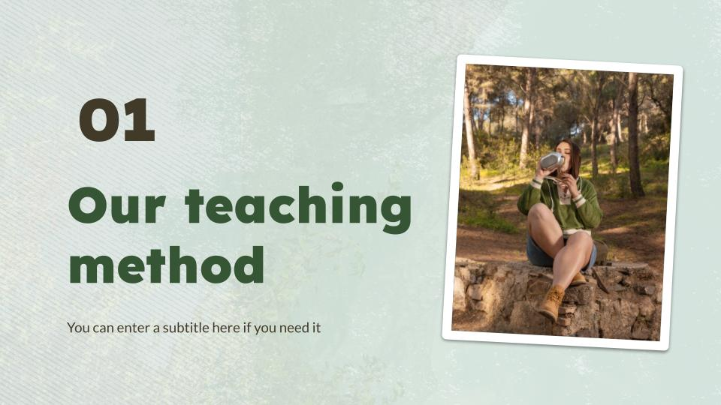

Interface
We can develop an interface for users to input their images in and our model will generate an output.

Slide 26
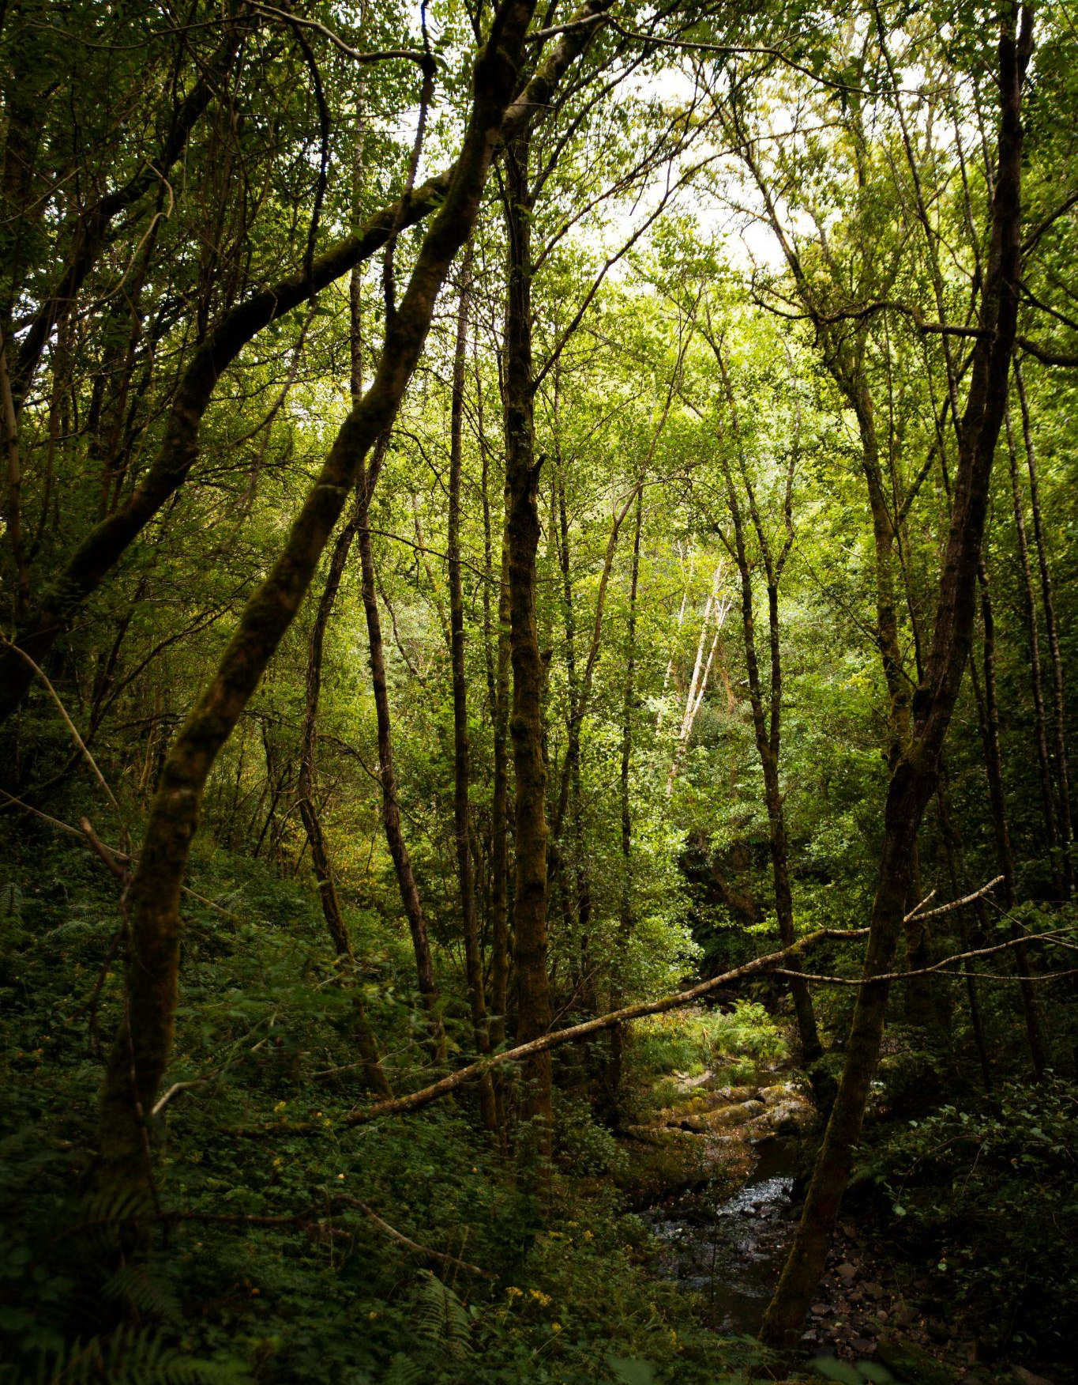
Thanks!

